Slide 1
Studying the Performance of IPv4 and IPv6
Submitted by:
Shreeram Kumar Singh (MT23091)
Shubham Kumar Choudhary (MT23093)
Nitesh Kumar Chaurasia (MT23053)
Tanmay Parashar (MT23100)
Group Number: 10

Slide 2
Problem Statement
Objective:
Evaluate and compare the performance of IPv6 and IPv4 by analyzing round-trip time (RTT) and server geolocation using 4G networks with different ISPs (Jio, Airtel) on different days.

Slide 3
Tools and Technologies Used
Batch Scripts: For testing websites using IPv4 and IPv6 on Windows.
CSV Files: Used for storing log data from different ISPs.
Ping Command: For measuring round-trip time (RTT) in both IPv4 and IPv6.
Windows Environment: Scripts executed on Windows OS.
Python: Used for data analysis and visualization (e.g., generating graphs based on RTT).

Slide 4
Progress and Achievements
Completed Tasks:
Batch Scripts:
Created and debugged scripts (ping_ipv4.bat and ping_ipv6.bat) for IPv4 and IPv6 pings.
Data Collection:
Conducted extensive tests using Jio, and Airtel ISPs.
Gathered RTT logs for approximately 100 websites over multiple days.

Slide 5
3. Server Geolocation Logging:
Retrieved server geolocation data for both IPv4 and IPv6.
Verified data accuracy with IP geolocation services.
4. Comprehensive Dataset:
Final dataset includes columns for:
Date, ISP, IPv4 Address, IPv6 Address
IPv4 RTT, IPv6 RTT
Server geolocation for IPv4 and IPv6

Slide 6
5. Data Analysis and Visualization:
Python scripts developed to analyze collected data.
Visualizations include:
Two Box Plots: One each for IPv4 and IPv6 RTT distribution.
Two Bar Graphs: Comparing IPv4 and IPv6 RTT for Jio and Airtel ISPs.
Two Line Graphs: Highlighting RTT trends for IPv4 and IPv6 on Jio and Airtel.
Two Bar Graph: Number of Unique Websites per Location and Number of locations per Website.

Slide 7
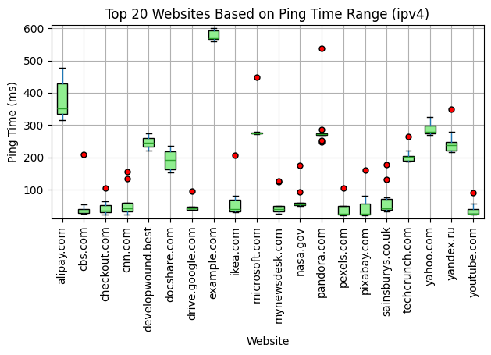

Slide 8
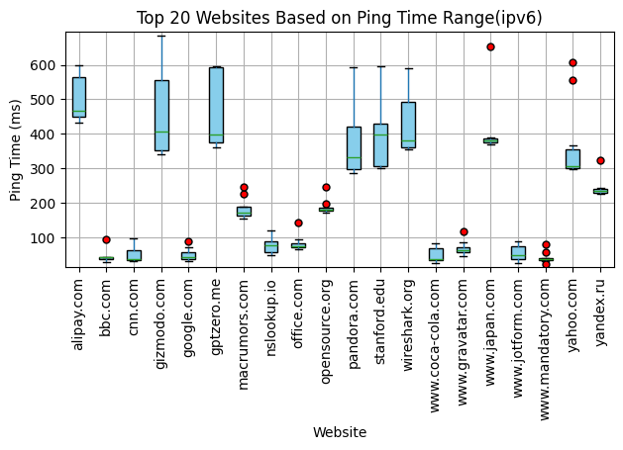

Slide 9
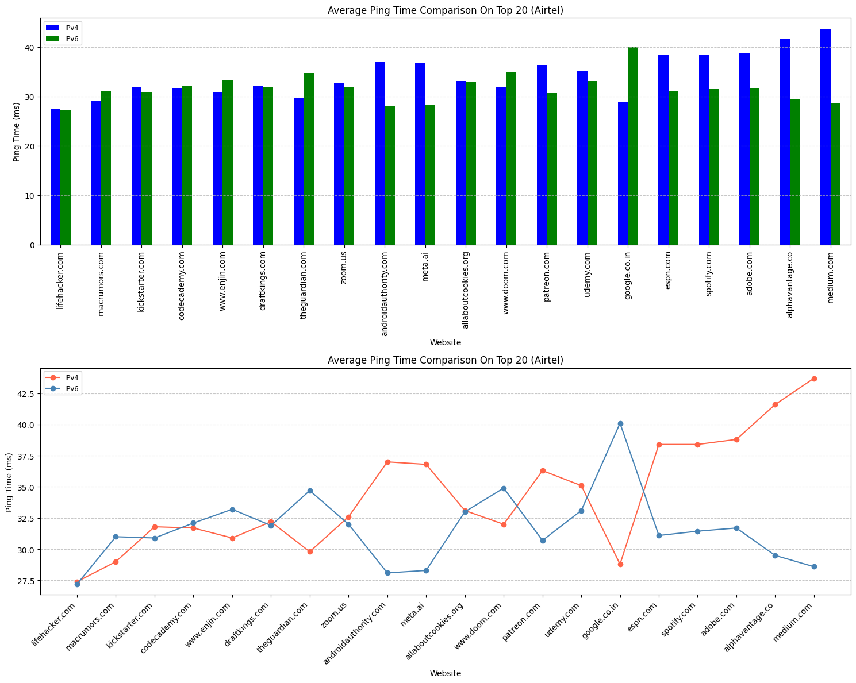

Slide 10
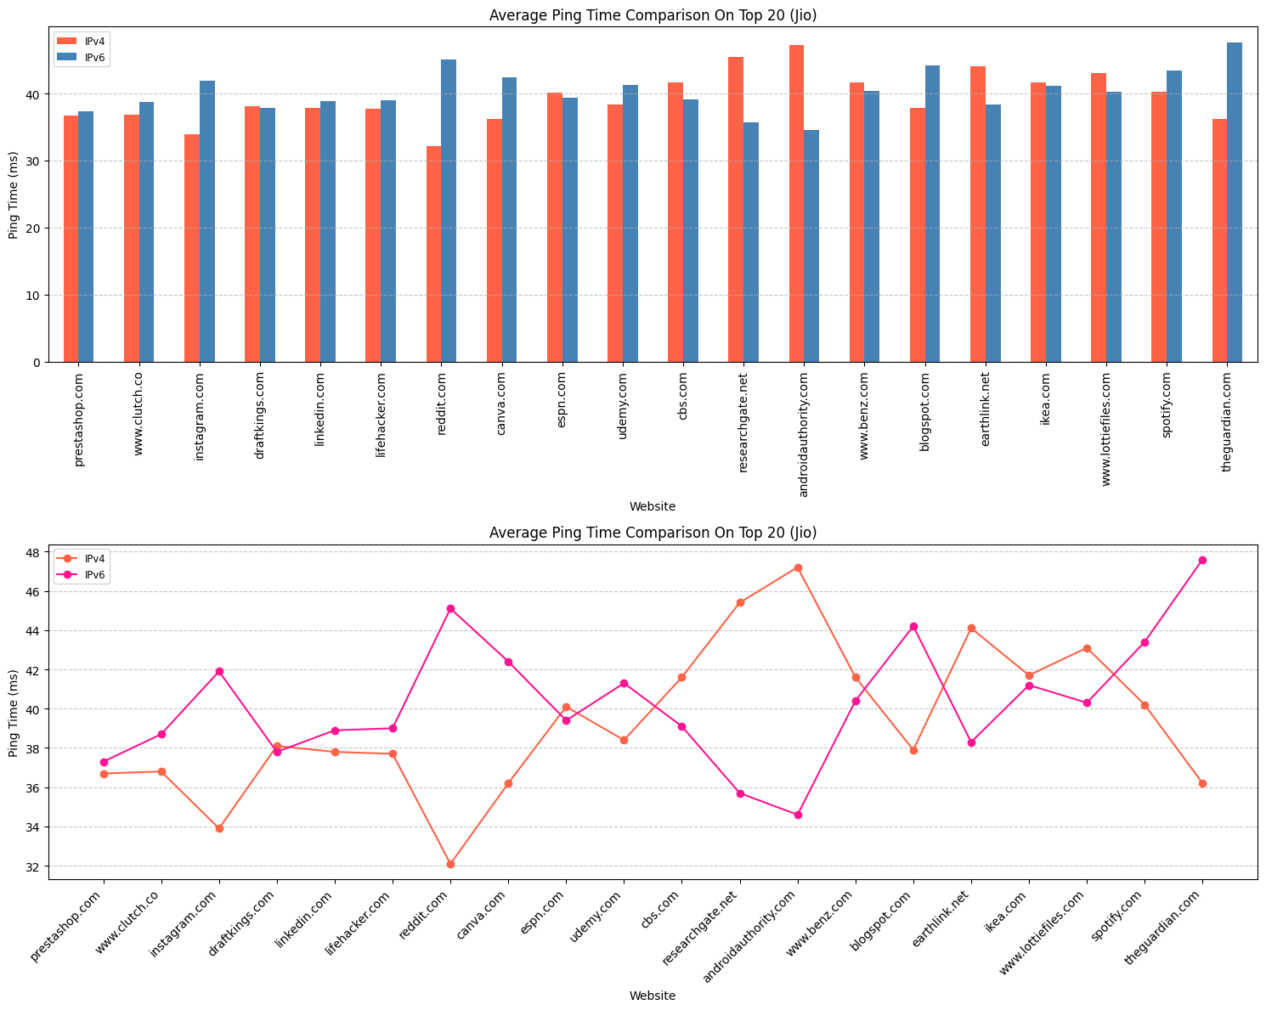

Slide 11
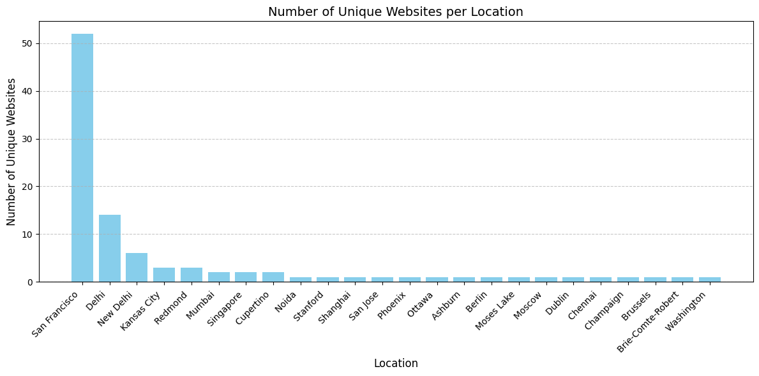

Slide 12
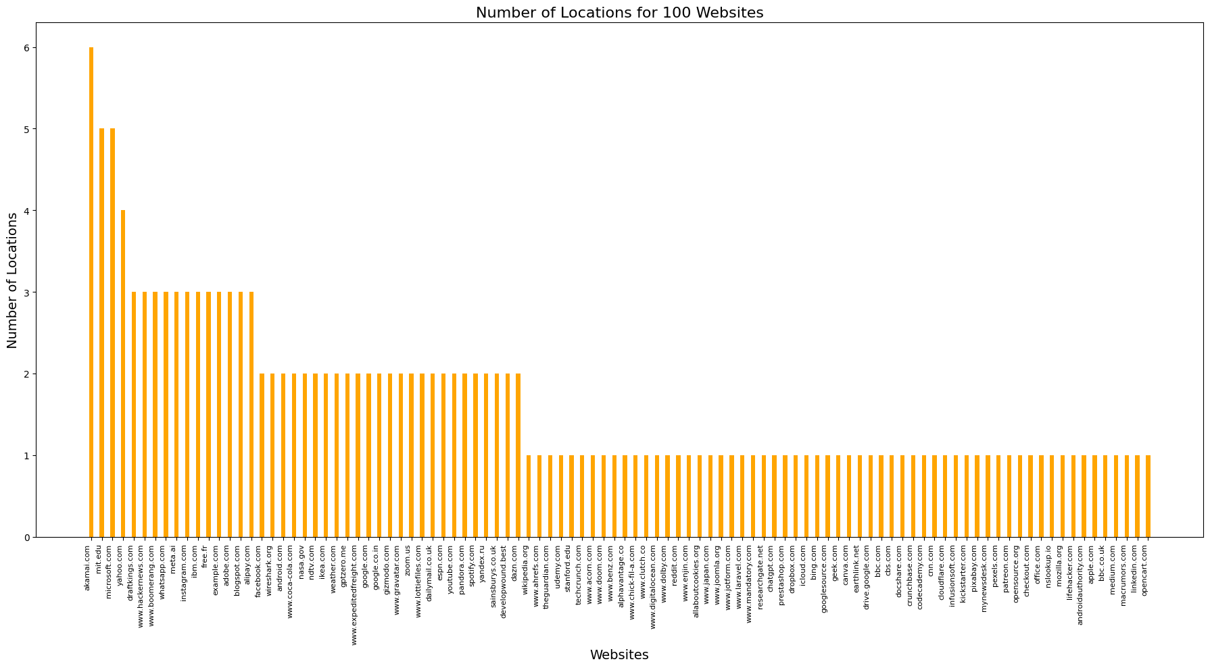

Slide 13
Key Insights
Round-Trip Time (RTT):
IPv6 generally shows higher RTT than IPv4 for most websites tested.
Significant variability observed across ISPs.

Slide 14
2. Geolocation Analysis:
IPv4 and IPv6 servers for the same website often have different physical locations.
Geolocation differences impact RTT values.
3. ISP Performance:
Variations in RTT suggest performance differences across Jio, and Airtel networks.

Slide 15
Final Deliverables
Batch Scripts: ping_ipv4.bat and ping_ipv6.bat for automated data collection.
Dataset: Comprehensive CSV files containing IPv4 and IPv6 logs.
Visualizations: Box plots, bar graphs, and line graphs for comparative analysis.
Server Geolocation Analysis: Tabular and visual insights into server locations and their impact on RTT.

Slide 16
Conclusion
The project successfully achieved its objectives by systematically collecting and analyzing IPv4 and IPv6 performance data. The insights derived highlight the evolving nature of IPv6 adoption and its impact on internet performance metrics. This study provides a solid foundation for future network performance research.

